Slide 1

Students testing application
Student:
Hundarchuk Vladyslav
Kyiv-2021

Slide 2









Used tools
- for store backend and frontend.
- for hosting servers.
- for creating servers in the cloud and configure securing groups.
- for run microservice architecture.
- for CI/CD.
- for store users and tests password and data.
- for creating site’s frontend and connecting API to him.
- for remote configuring servers.
- for creating backend API’s.

Slide 3
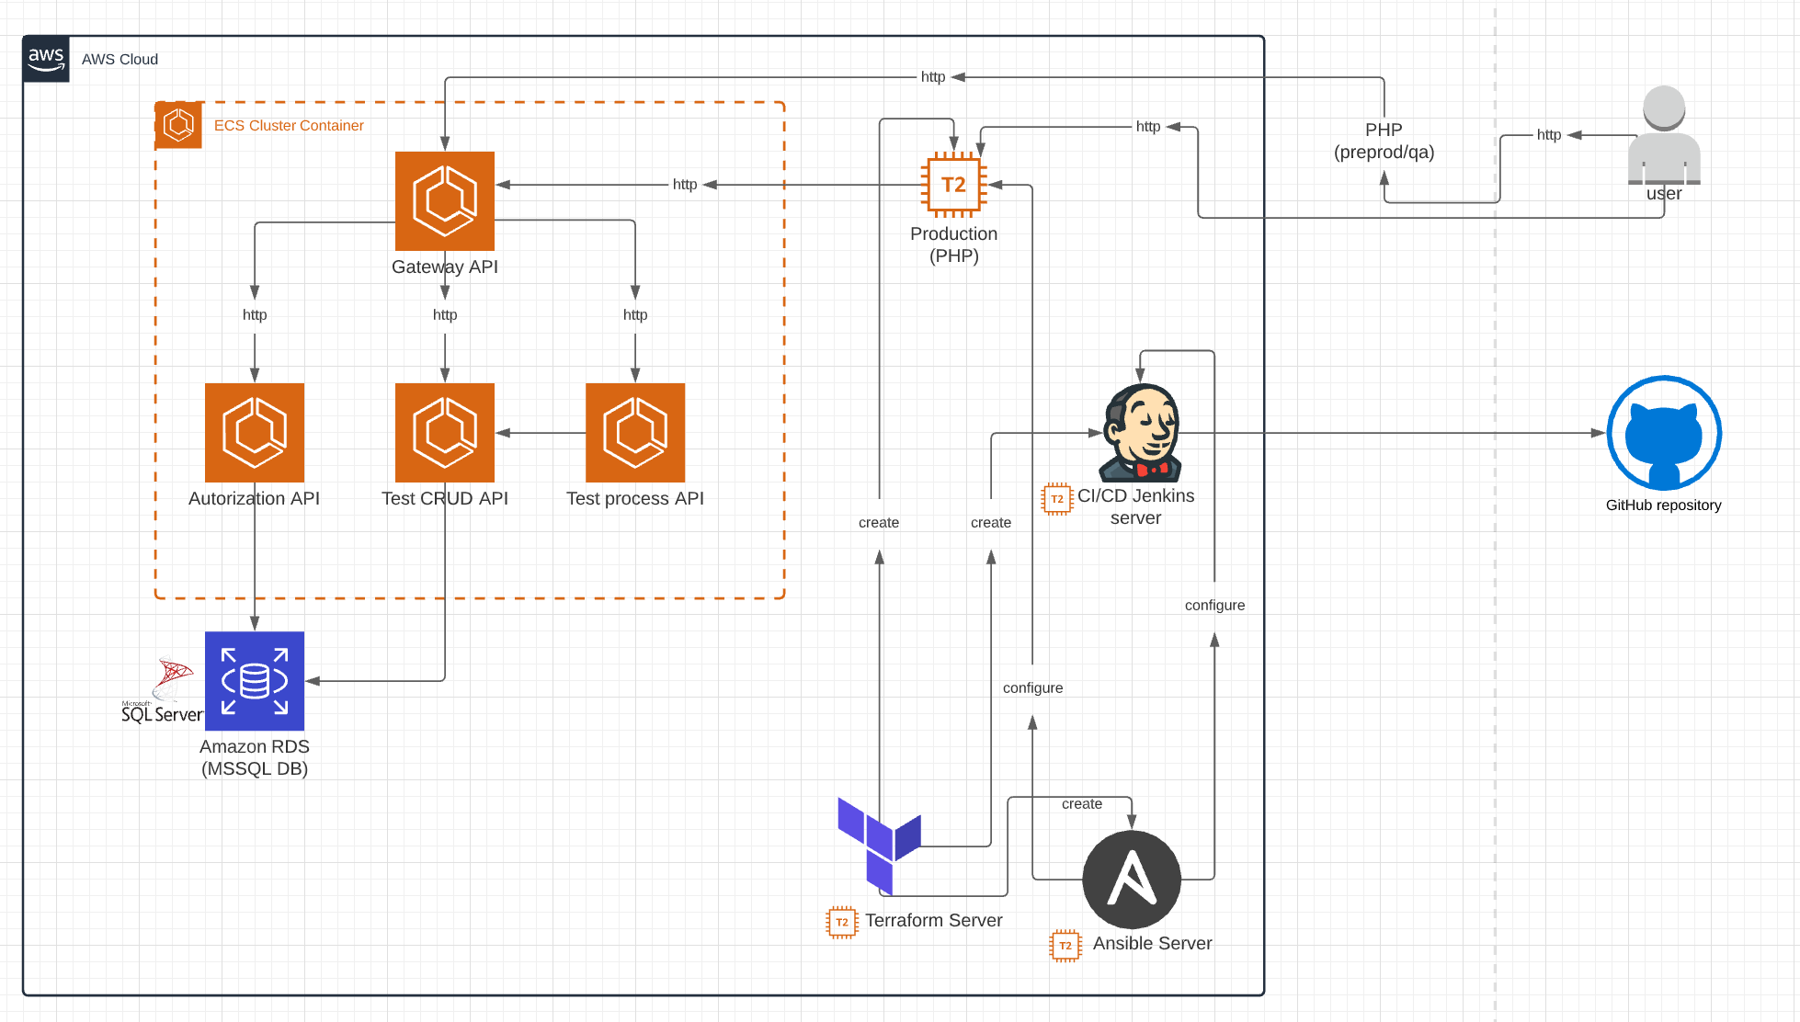
Project infrastructure

Slide 4

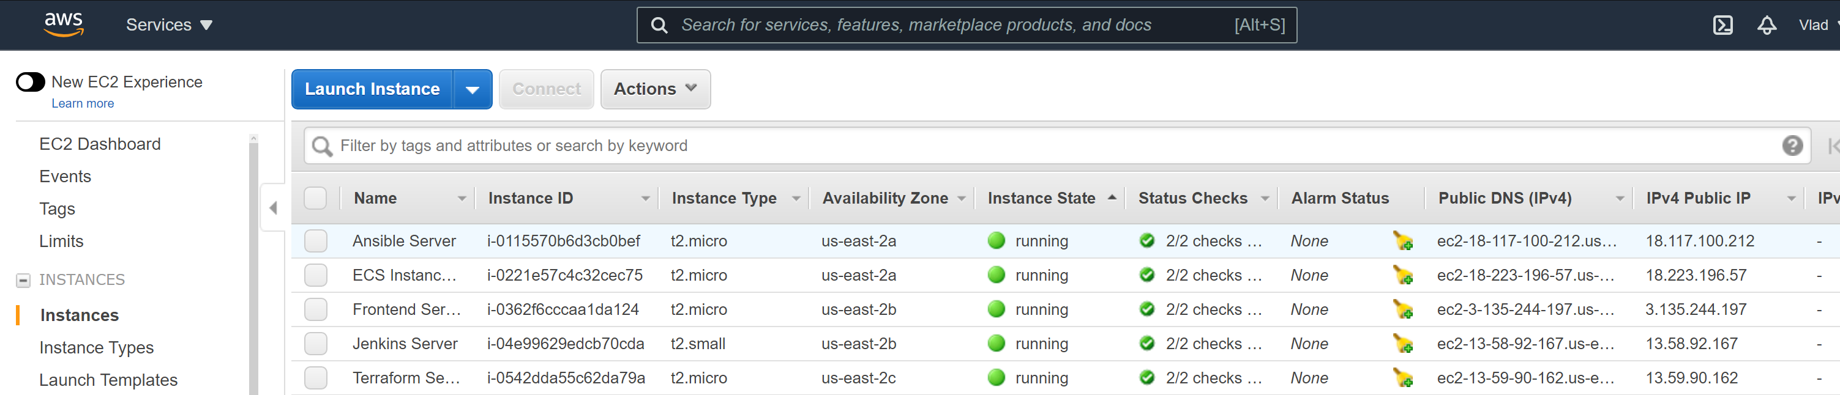
Instances
Ansible Server – server for configure other servers.
Jenkins Server – server for CI/CD and Jenkins.
Frontend Server – server for host the frontend(using nginx).
ECS Server – microservice cluster instance.
Terraform Server – server for creating other instances.

Slide 5

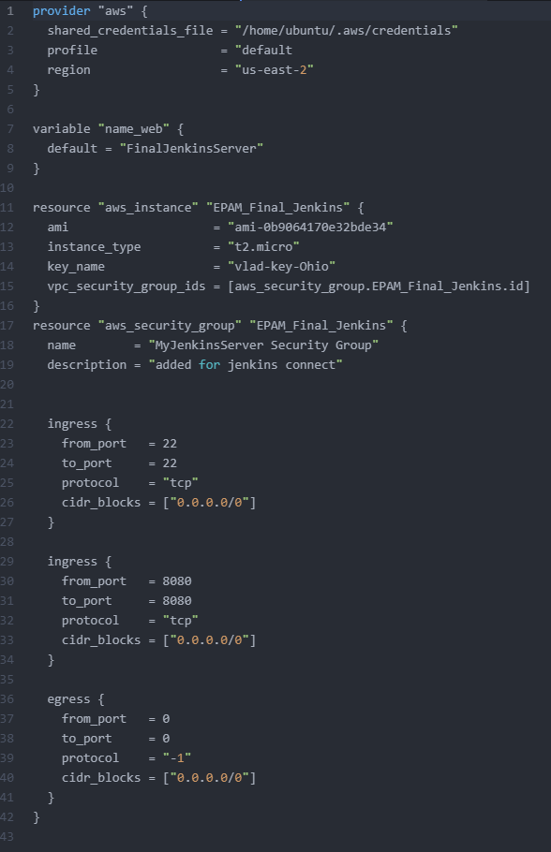
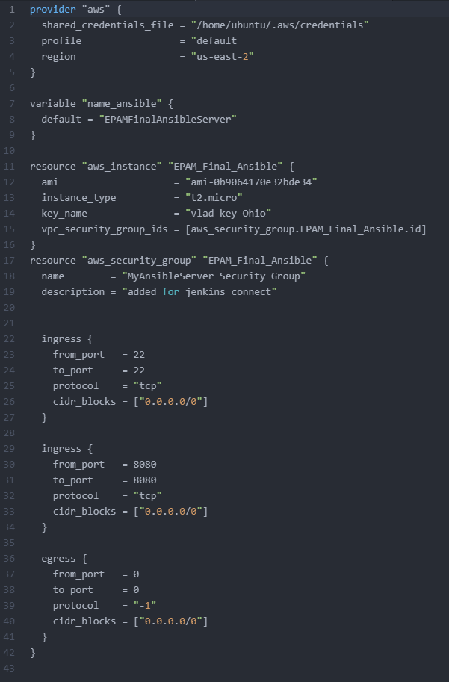
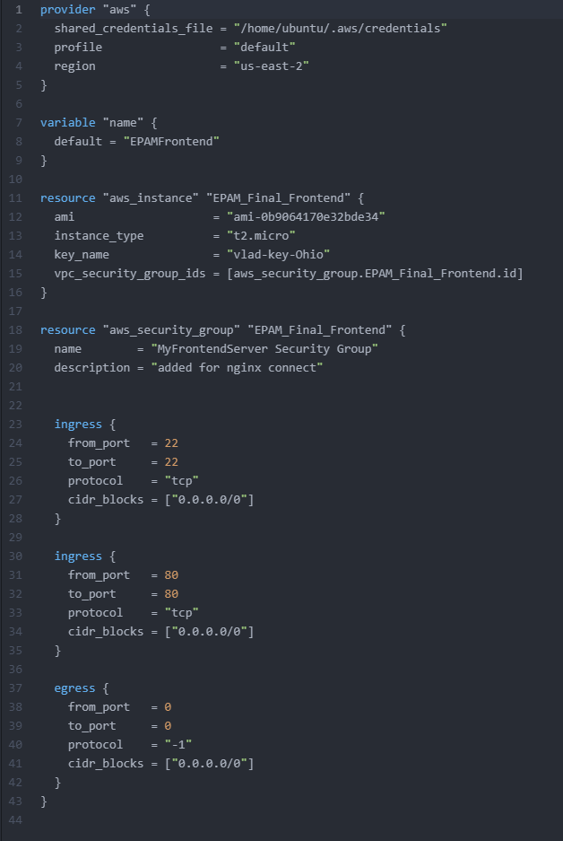
Terraform
Jenkins Server:
Ansible Server:
Frontend Server:

Slide 6

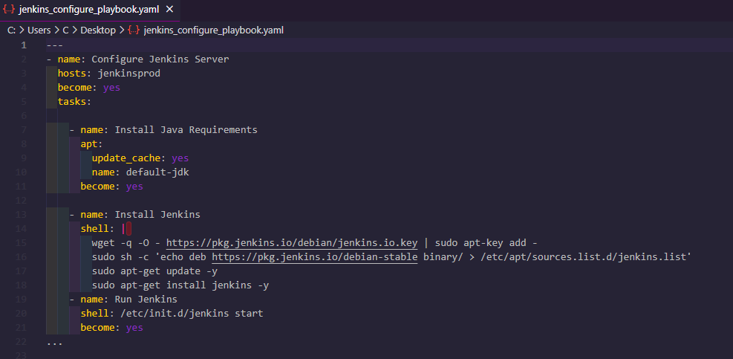
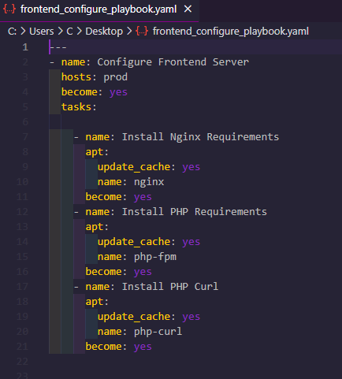
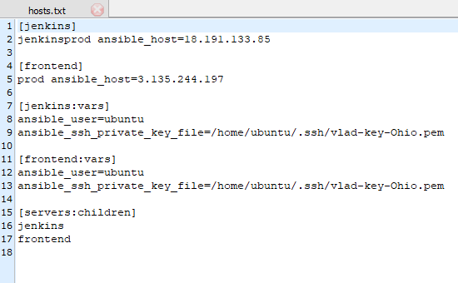
Ansible
Configure Frontend Server
Configure Jenkins Server
Hosts file

Slide 7

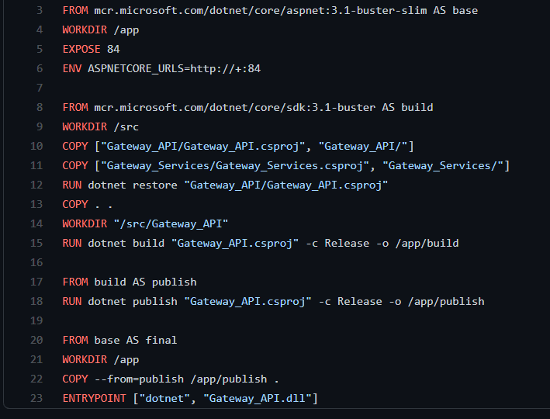
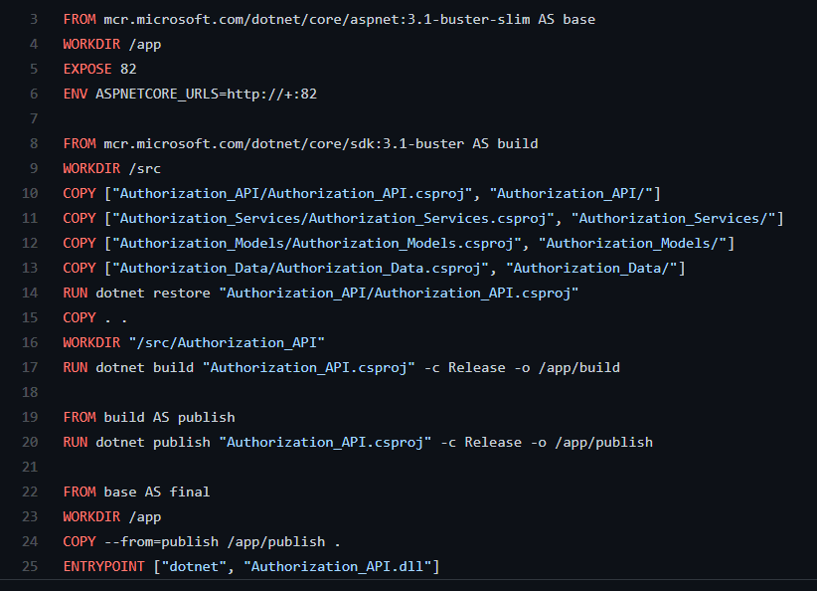
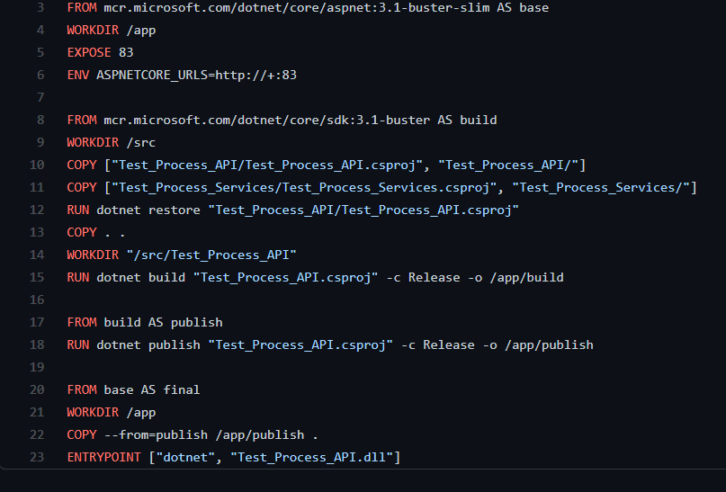
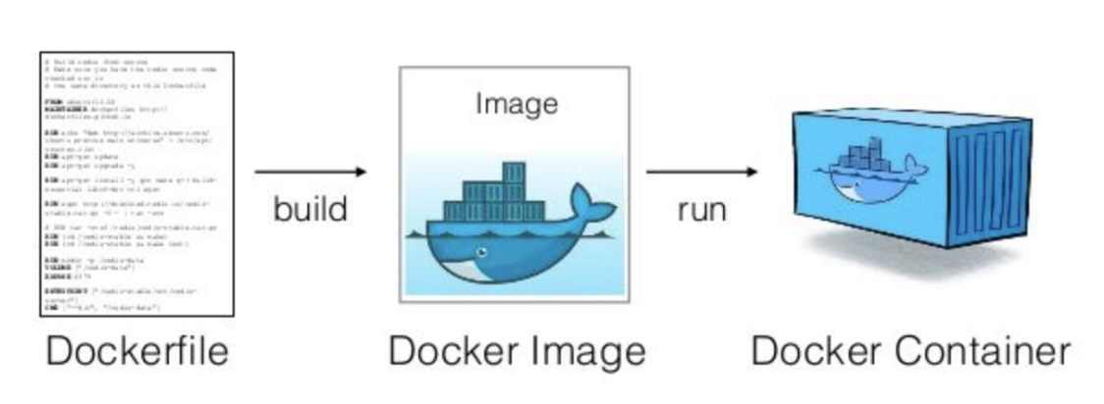
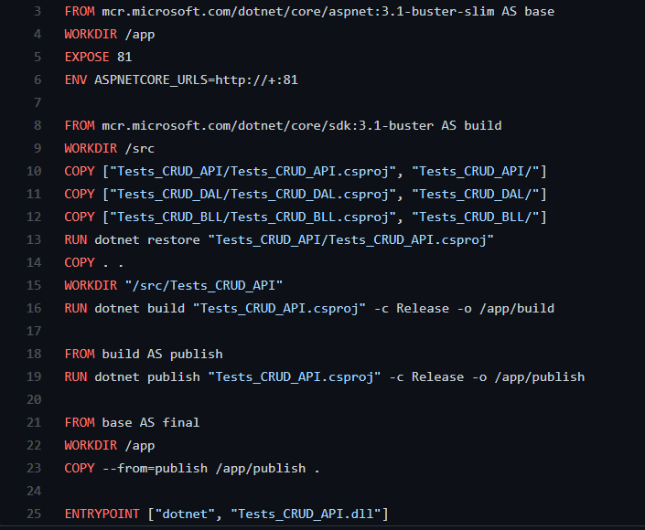
Amazon ECR Dockerfiles (Elastic Container Registry)
Gateway API Dockerfile
Authorization API Dockerfile
Process API Dockerfile
CRUD API Dockerfile

Slide 8

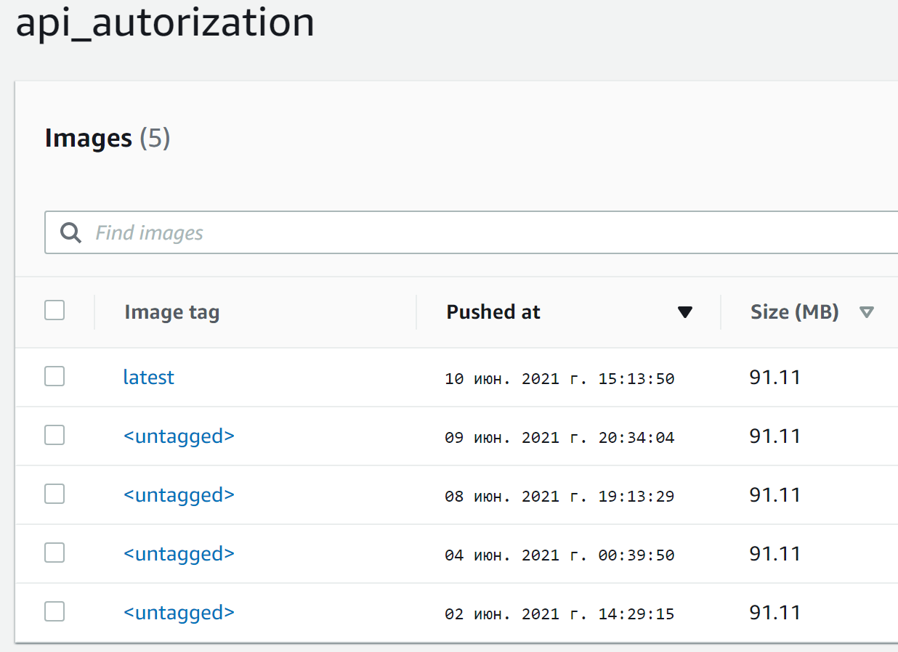
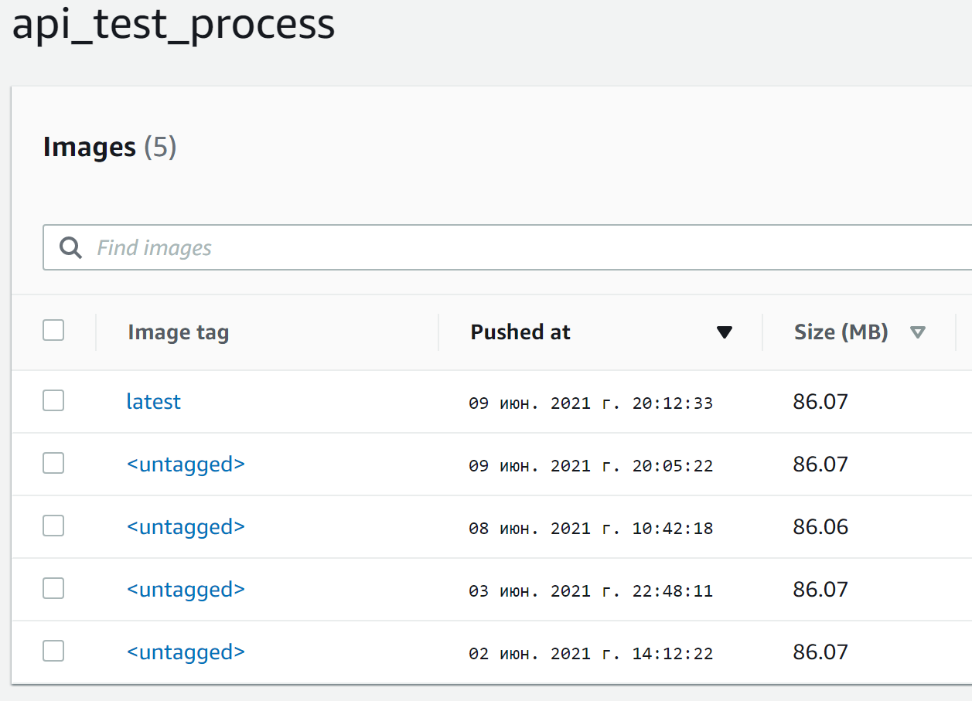

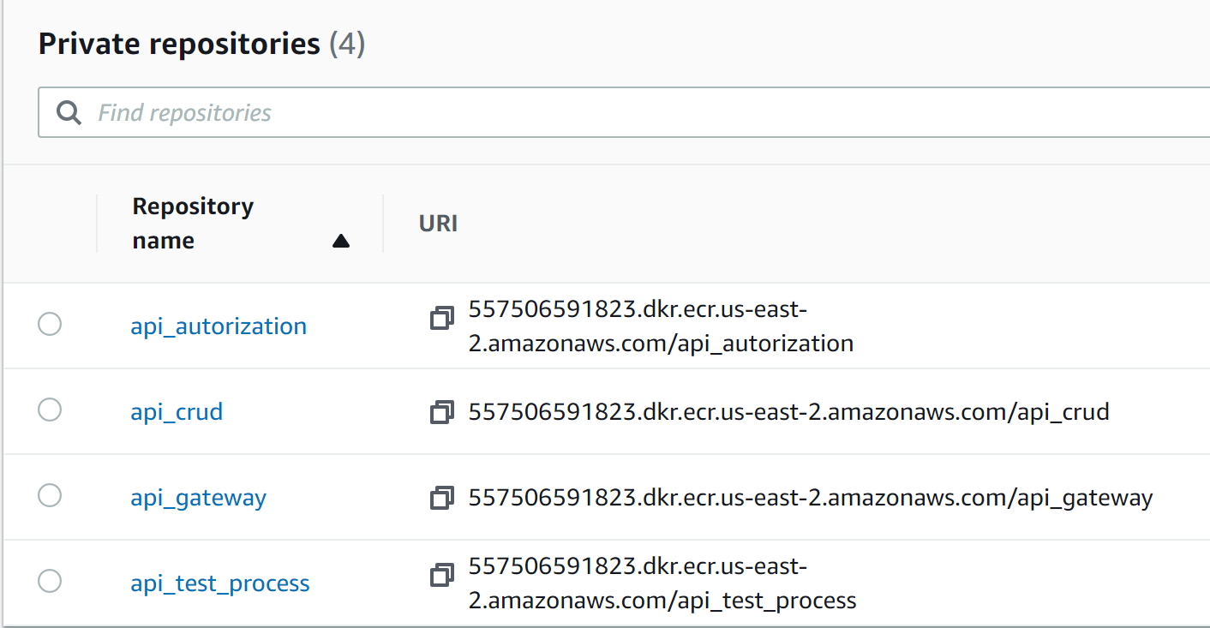
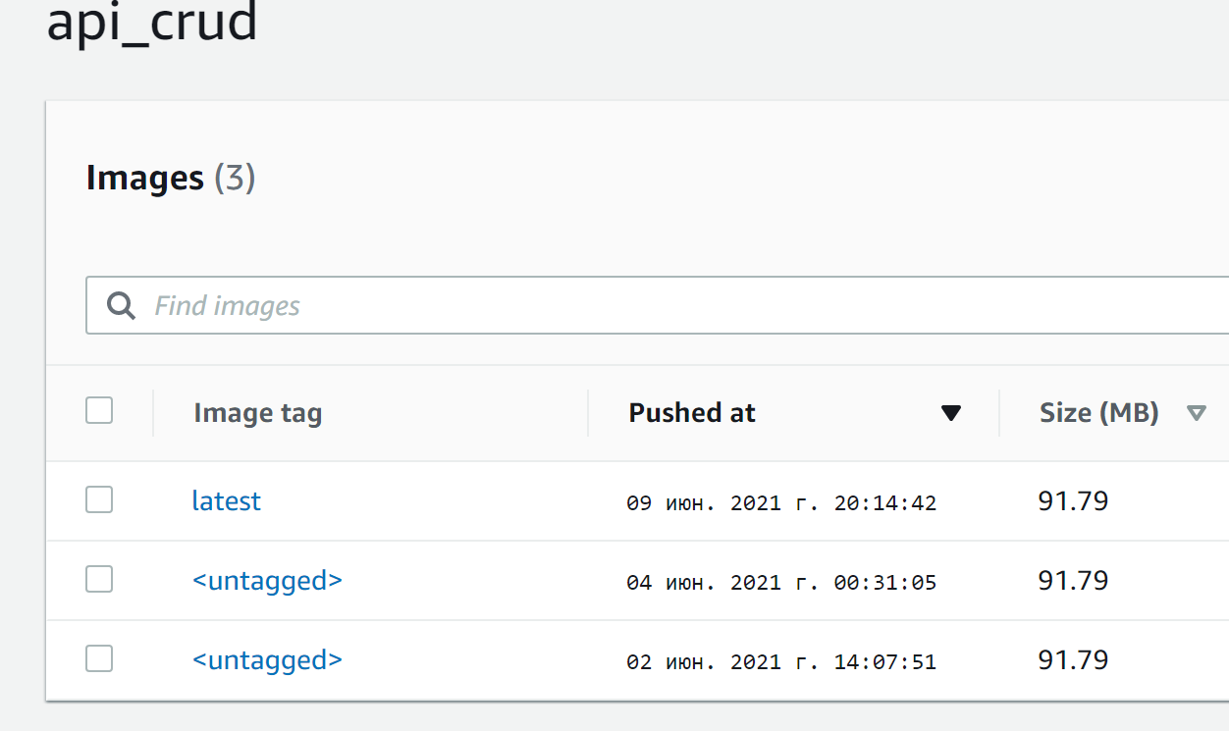
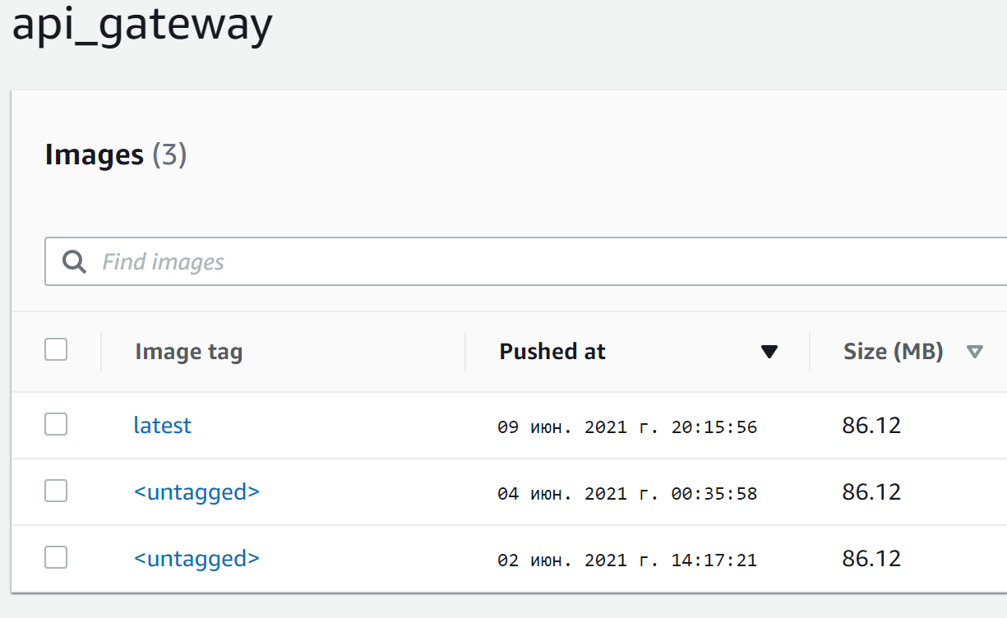
ECR Repositories
Authorization API builds
Test Process API builds
Repositories
CRUD API builds
Gateway API builds

Slide 9

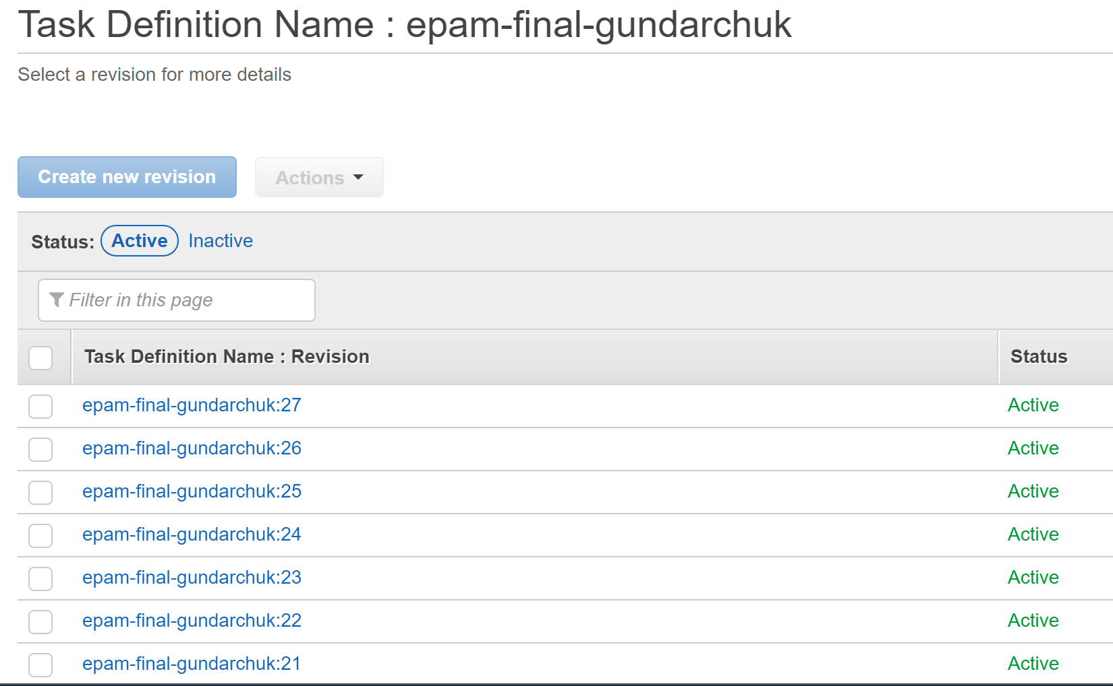
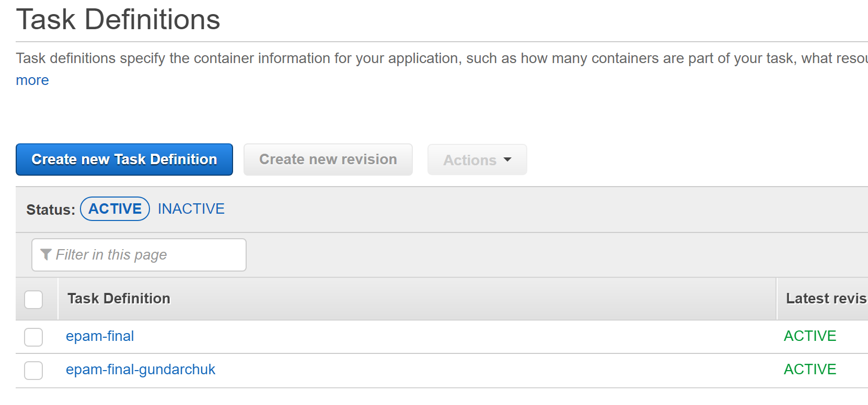
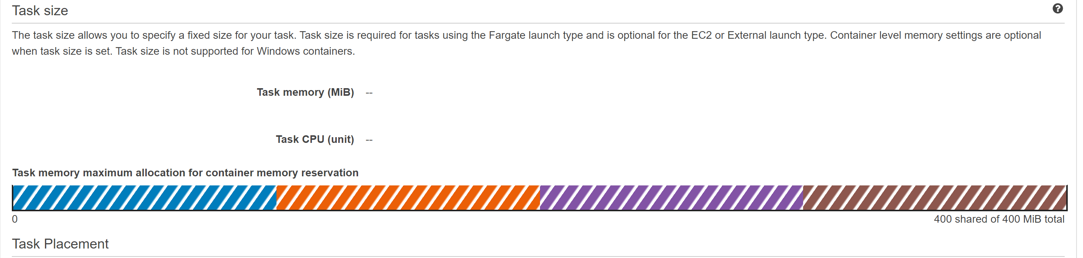
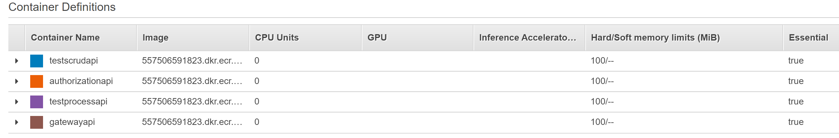
ECS Task definitions
Task definition revisions ( Jenkins CD create new revision)
Task definitions
Load balancer
Containers inside task definition

Slide 10
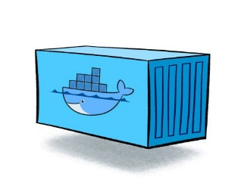
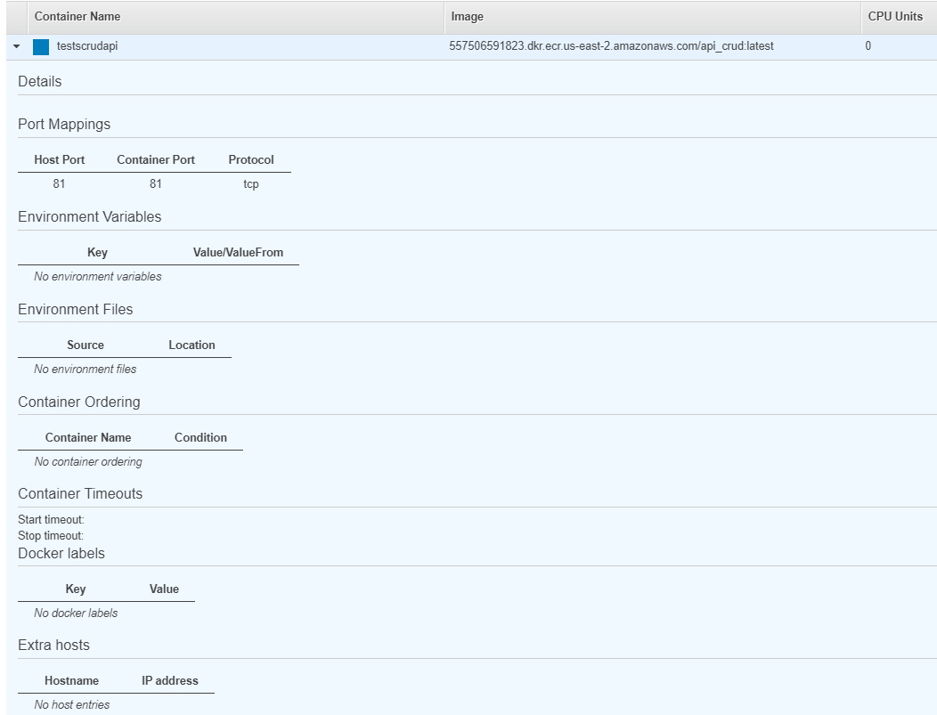
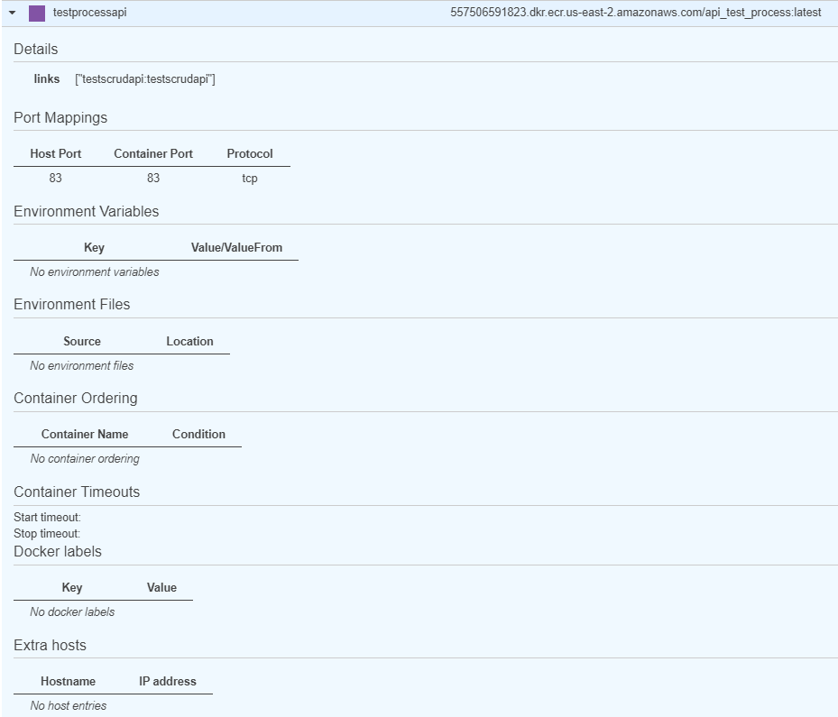
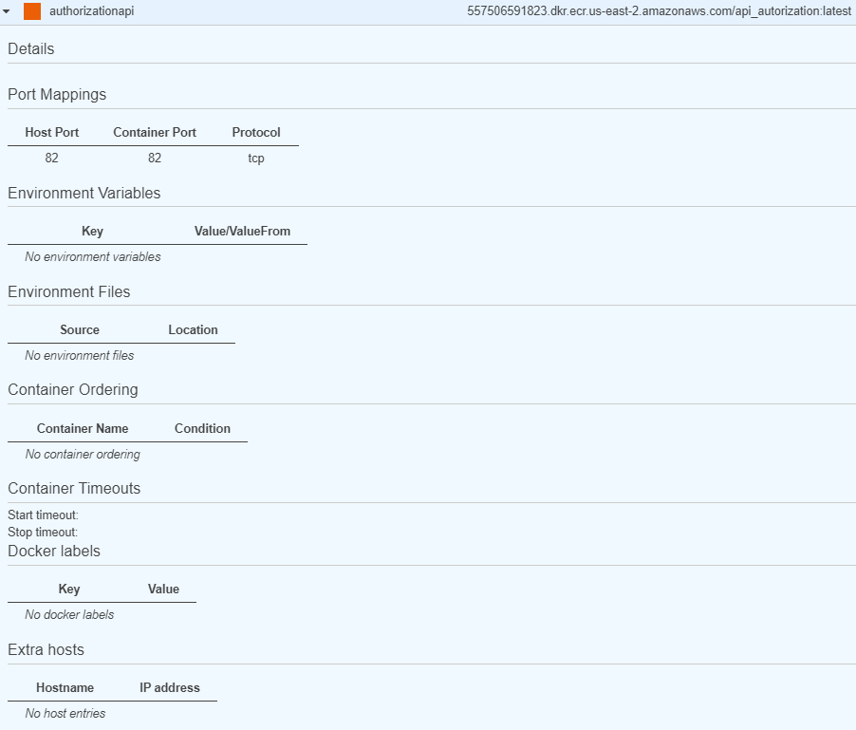
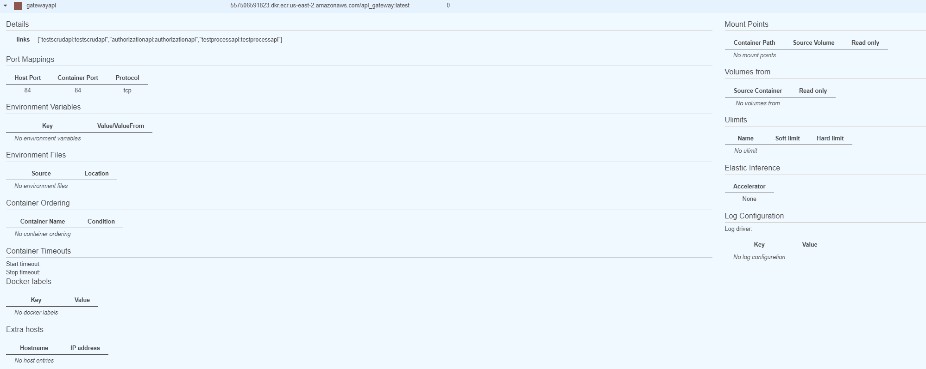
Task Containers
Crud API container
Test Process API container
Authorization API container
Gateway API container

Slide 11
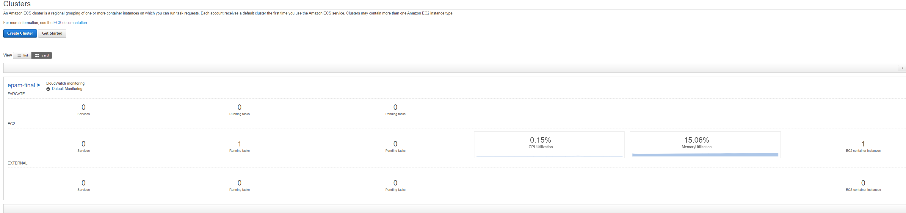
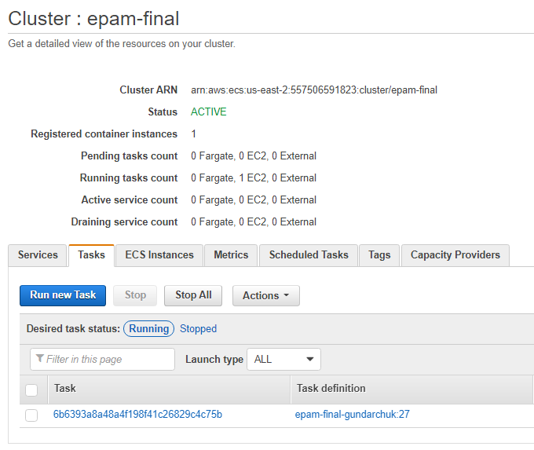
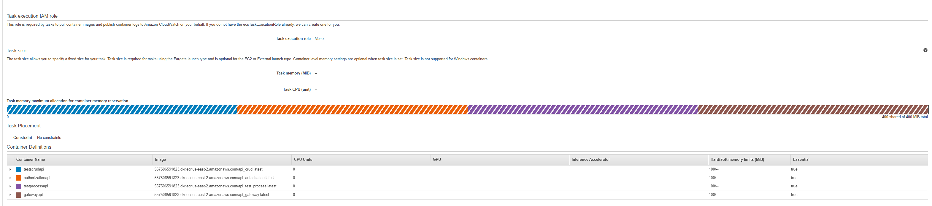
ECS Cluster
Cluster
Cluster task
Inside task

Slide 12

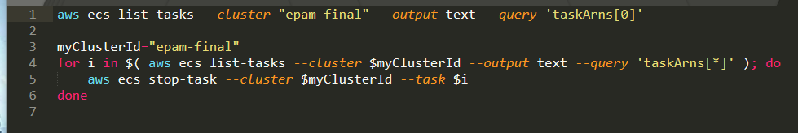
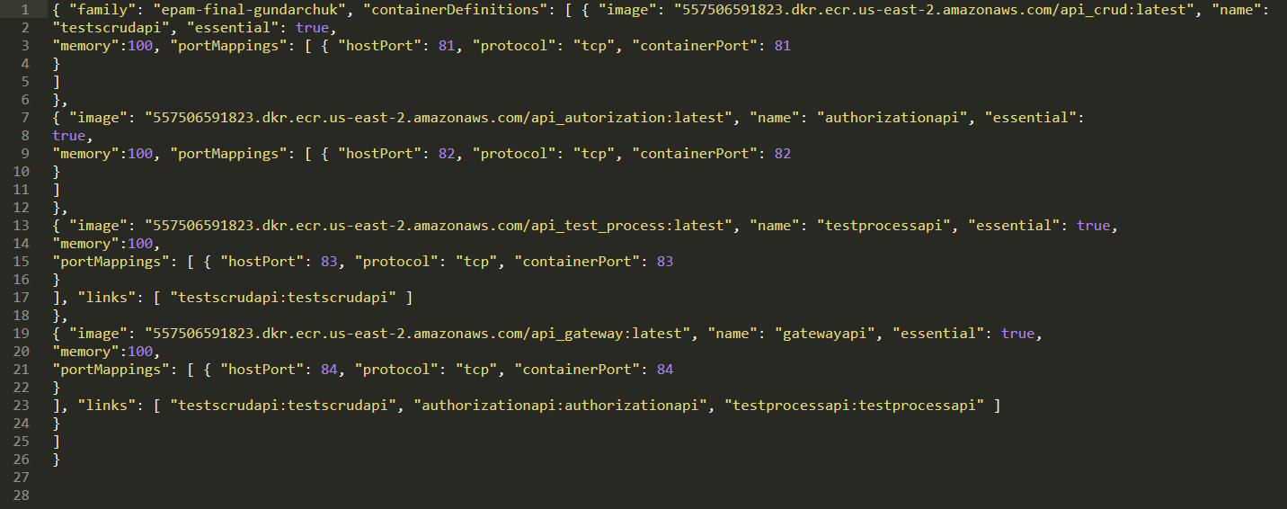
Jenkins scripts
Script for remove task definition from cluster:
Definition of containers in task definition:

Slide 13

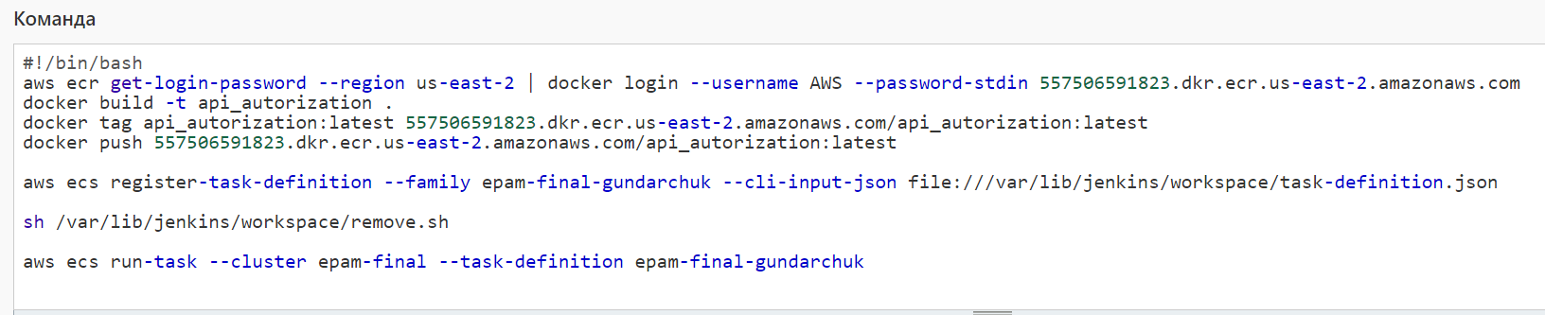
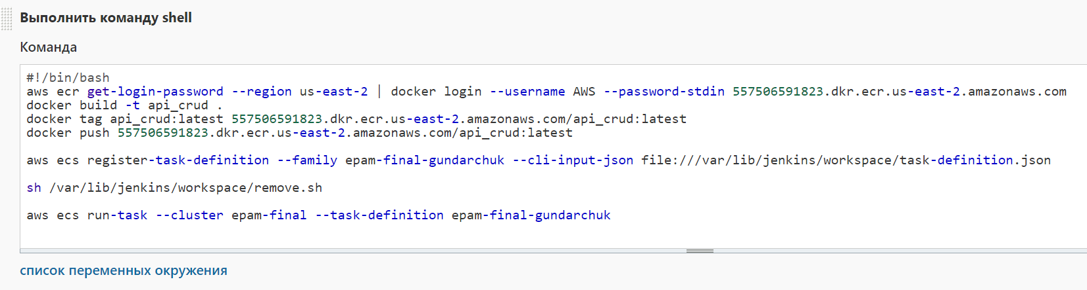
Jenkins Jobs (Path one)
Authorization API CI/CD job:
CRUD API CI/CD job:

Slide 14
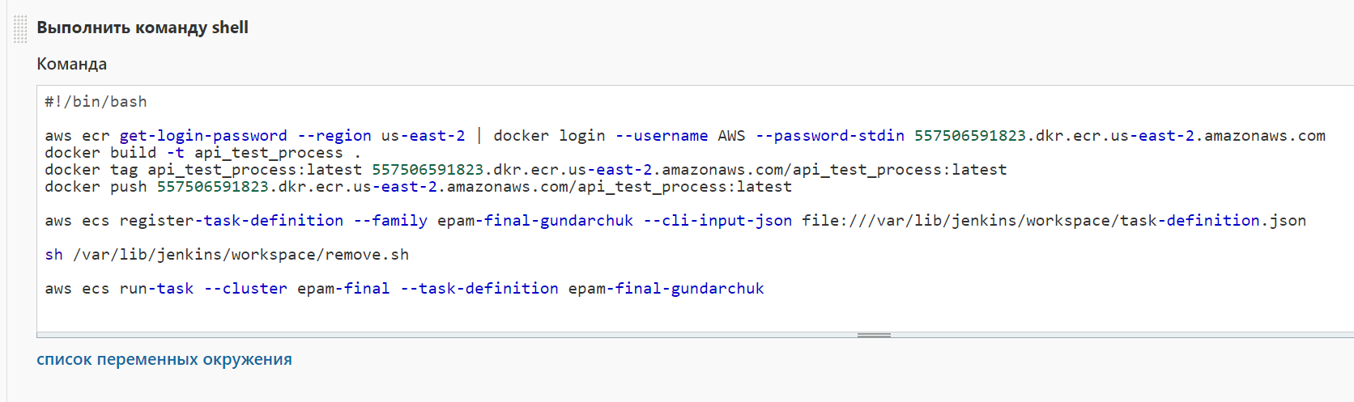
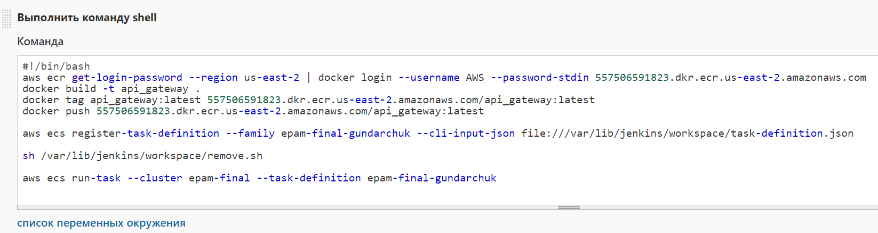
Jenkins Jobs (Path two)
Test Process API CI/CD job:
Gateway API CI/CD job:

Slide 15

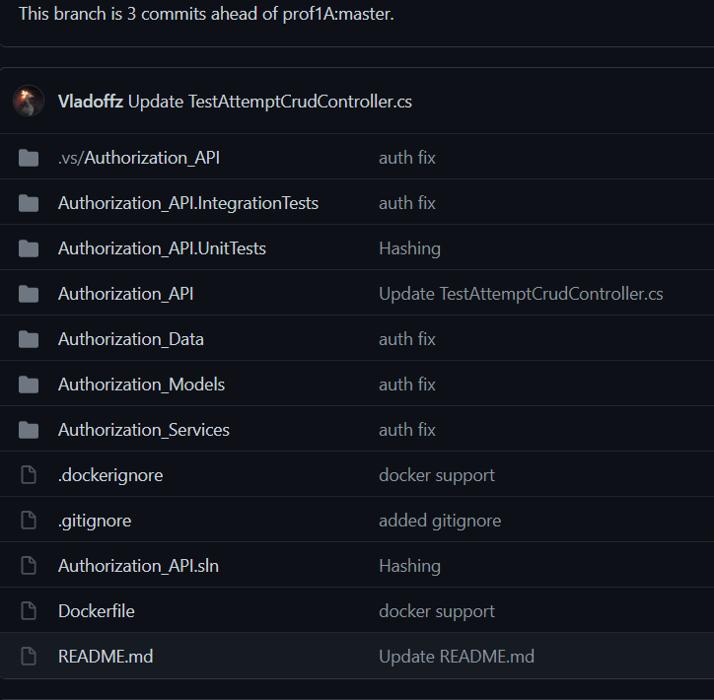
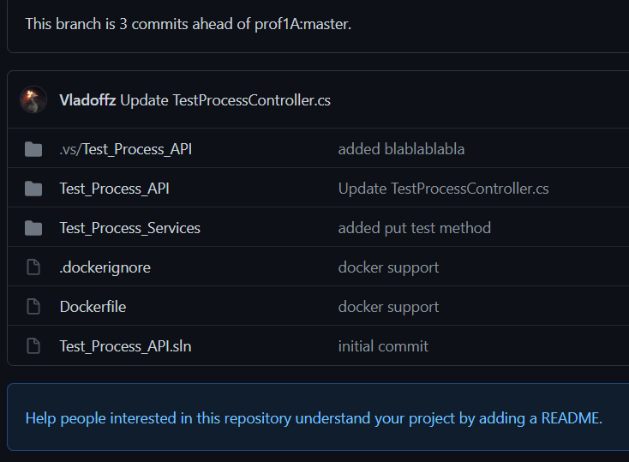
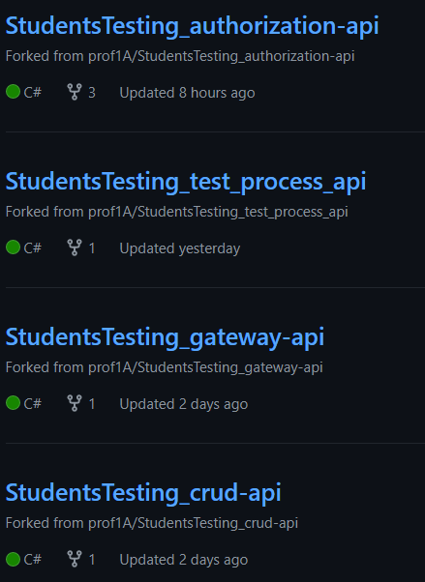
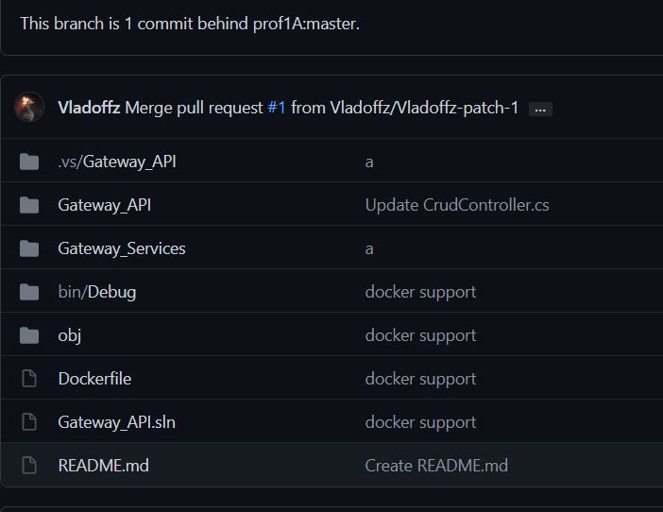
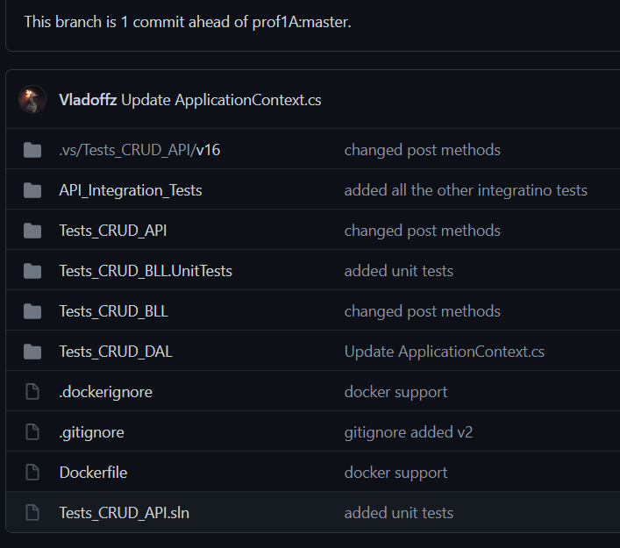
Github Repositories
Authorization API Repository:
Test Process API Repository:
Backend Repositories:
Gateway API Repository:
CRUD API Repository:

Slide 16

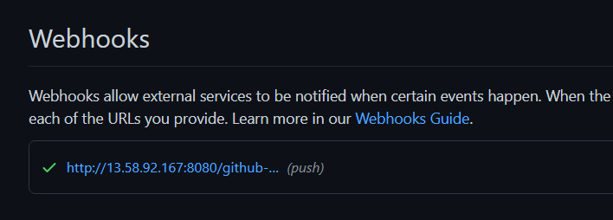
Github Webhooks for Jenkins
Authorization API Webhook:
Gateway API Webhook:
CRUD API Webhook:
Test Process API Webhook:

Slide 17

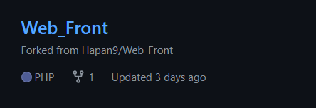
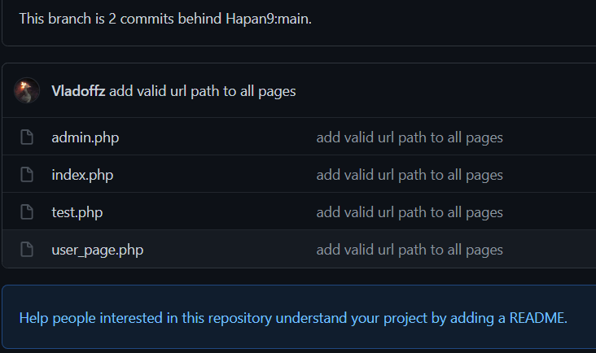

Frontend Server
Frontend GitHub repository:
Inside repository:

Slide 18
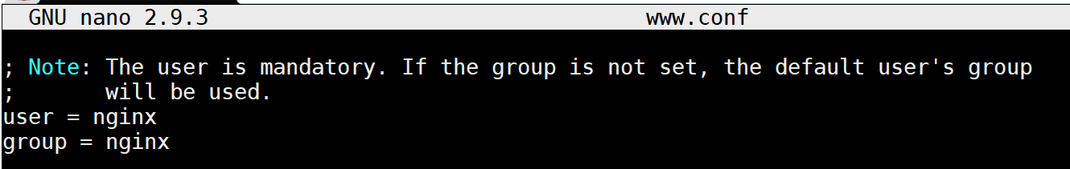
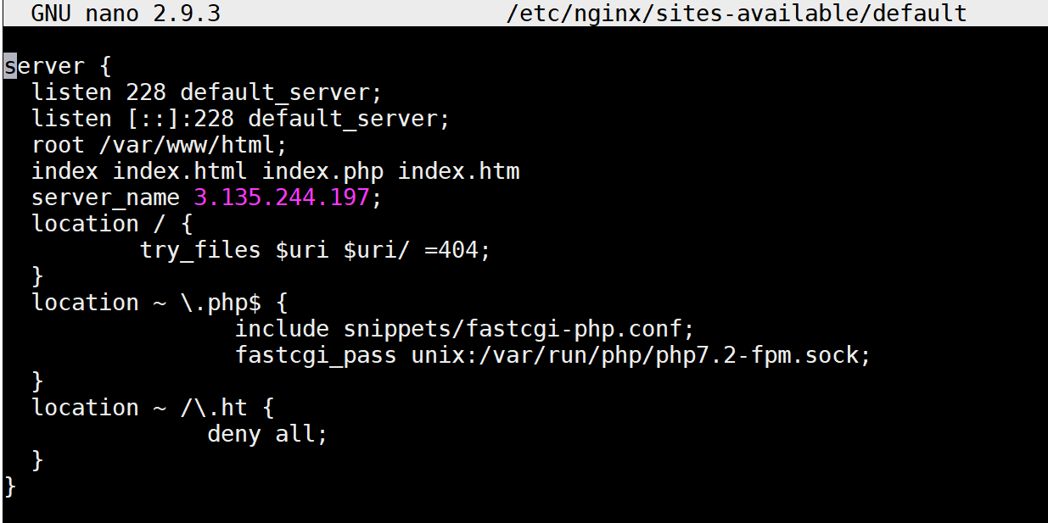
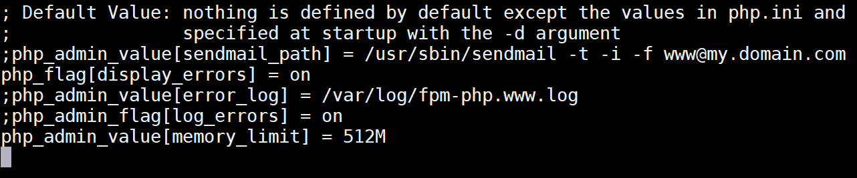
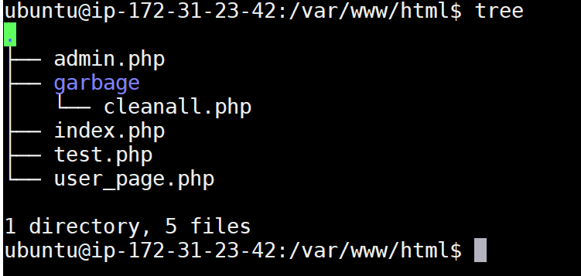
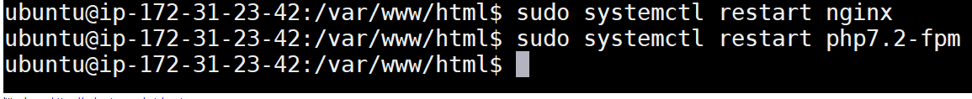
Configure Frontend Server for nginx:
Second step – configure www.conf in /etc/php/7.2/fpm/pool.d:
First step - configure default file:
Third step – copy files to /var/www/html:
Fourth step – restart nginx and php-fpm services:

Slide 19
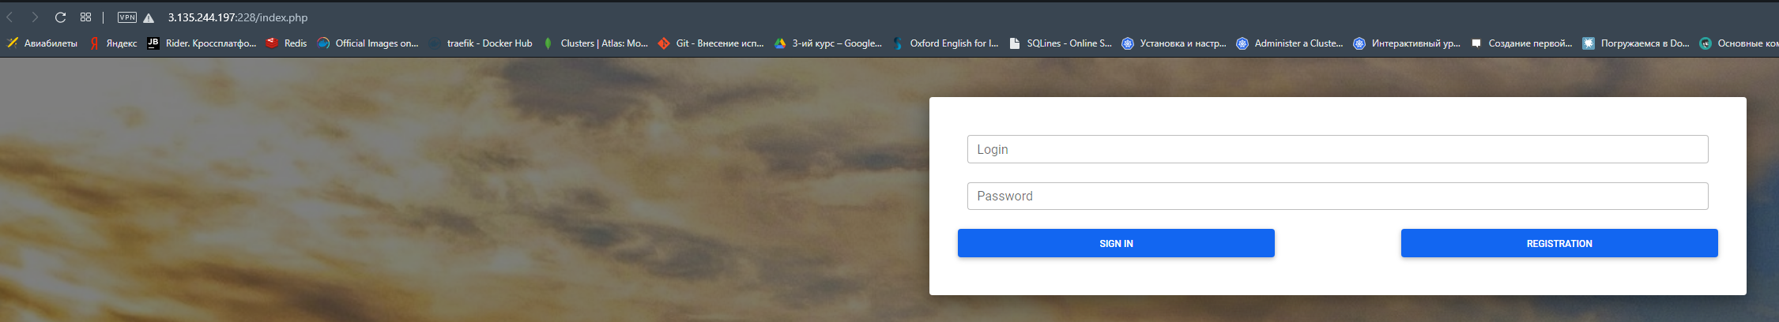

Work result (path one)
Main page:
Admin page:

Slide 20


Work result (path two)
User page with tests:
Tests page:

Slide 21





RDS Database (Microsoft SQL)
Databases:
CRUD database tables:
Admin database tables:
User database tables:

Slide 22


Swagger
Swagger for graphic documentation API:

Slide 23

Thanks for you attentions!
Project by Vlad Hundarchuk
Github: https://github.com/Vladoffz

